Slide 1
Junior AI Engineer Project Assignment
A presentation by George Siougles

Slide 2
Tools and Tech Stack
Visual Studio Code
Github
Github actions
Docker
Python
SQLite
FastAPI
API set up
Templates

Slide 3
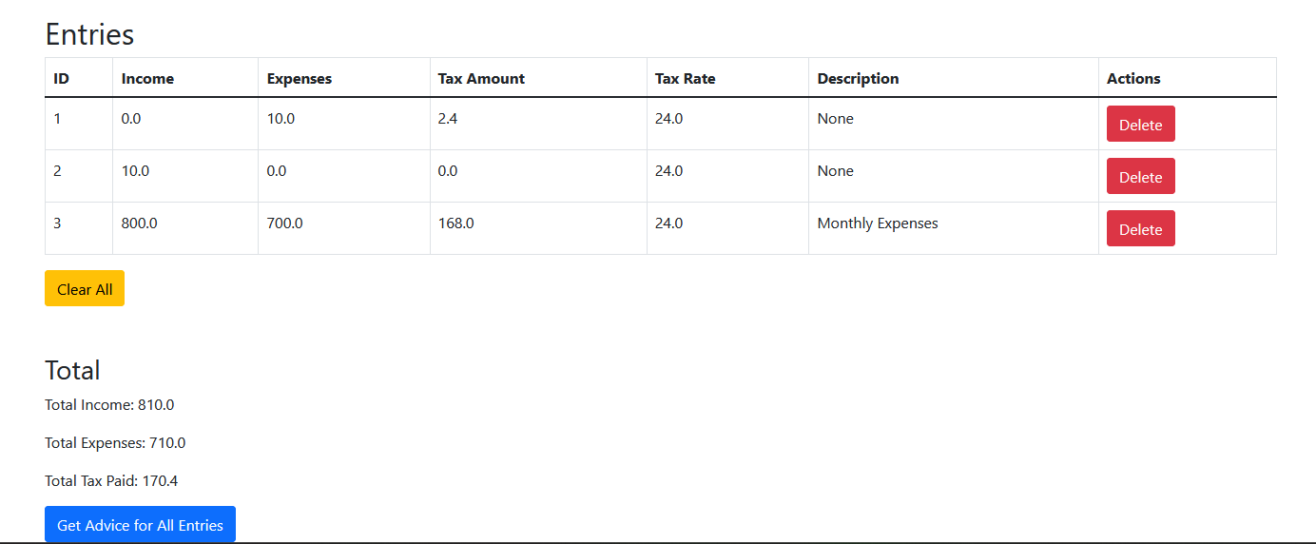
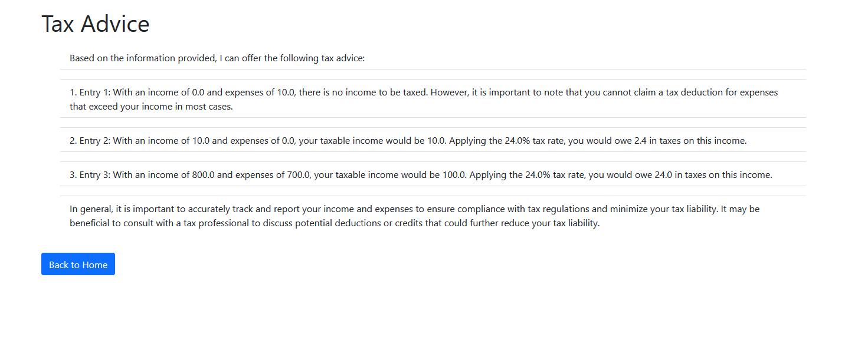

Slide 4
Challenges met
Learning Python
Setting up testing environments
Separation of concerns

Slide 5
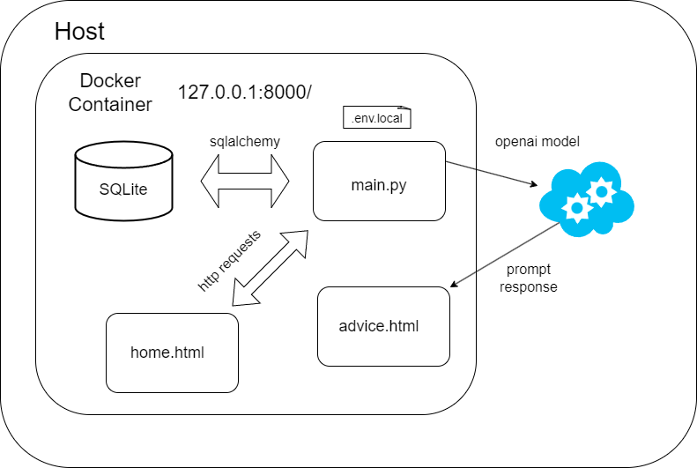
Project Structure

Slide 6
Thanks for your attention
George Siougles (gsiougles@outlook.com)

